Slide 1

UNIVERSITY INSTITUTE OF ENGINEERING
COMPUTER SCIENCE ENGINEERING
Machine Learning
23CSH-651
By Dr. Meena Pundir
INTRODUCTION
DISCOVER . LEARN . EMPOWER

Slide 2

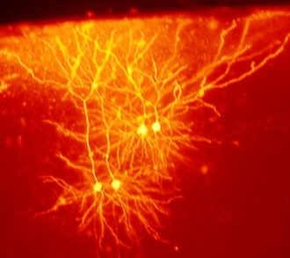



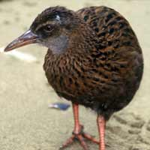
Introduction to Classification

Slide 3
What is classification?
A machine learning task that deals with identifying the class to which an instance belongs
A classifier performs classification
Classifier
( Textual features : Ngrams )
( Age, Marital status,
Health status, Salary )
( Perceptive inputs )
Test instance
Attributes
(a1, a2,… an)
Discrete-valued
Class label
Category of document? {Politics, Movies, Biology}
Steer? { Left, Straight, Right }
Issue Loan? {Yes, No}

Slide 4
Classification learning
Training
phase
Testing
phase
Learning the classifier
from the available data
‘Training set’
(Labeled)
Testing how well the classifier
performs
‘Testing set’

Slide 5
Generating datasets
Methods:
Holdout (2/3rd training, 1/3rd testing)
Cross validation (n – fold)
Divide into n parts
Train on (n-1), test on last
Repeat for different combinations
Bootstrapping
Select random samples to form the training set

Slide 6
Evaluating classifiers
Outcome:
Accuracy
Confusion matrix
If cost-sensitive, the expected cost of classification ( attribute test cost + misclassification cost)
etc.

Slide 7
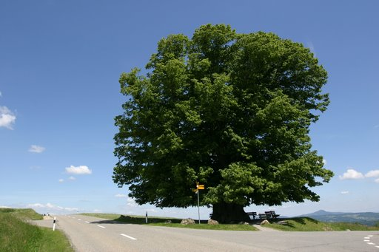
Decision Trees

Slide 8
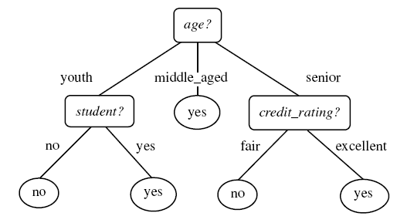
Example tree
Intermediate nodes : Attributes
Edges : Attribute value tests
Leaf nodes : Class predictions
Example algorithms: ID3, C4.5, SPRINT, CART
Diagram from Han-Kamber

Slide 9
Example tree
Intermediate nodes : Attributes
Edges : Attribute value tests
Leaf nodes : Class predictions
Example algorithms: ID3, C4.5, SPRINT, CART
Diagram from Han-Kamber

Slide 10

Decision Tree Issues
How to avoid overfitting?
Problem: Classifier performs well on training data, but fails
to give good results on test data
Example: Split on primary key gives pure nodes and good
accuracy on training – not for testing
Alternatives:
Pre-prune : Halting construction at a certain level of tree /
level of purity
Post-prune : Remove a node if the error rate remains
the same without it. Repeat process for all nodes in the d.tree
How does the type of attribute affect the split?
Discrete-valued: Each branch corresponding to a value
Continuous-valued: Each branch may be a range of values
(e.g.: splits may be age < 30, 30 < age < 50, age > 50 )
(aimed at maximizing the gain/gain ratio)
How to determine the attribute for split?
Alternatives:
Information Gain
Gain (A, S) = Entropy (S) – Σ ( (Sj/S)*Entropy(Sj) )
Other options:
Gain ratio, etc.

